Slide 1
Hand Gesture Recognition
Omkar Bhatkande (6)
Shadab Gada (14)
Onkar Paste (58)
Prem Surana (78)
Varad Vanjape (80)

Slide 2
Problem Statement
To implement a system for doctors in situations where access to keyboard/mouse is not possible, which recognizes their hand gestures through webcam and then invokes the predefined desktop application to perform specific actions.

Slide 3
Motivation
Situation where Physical access to keyboard is not possible
Most systems use Gloves or colour markers for gesture recognition

Slide 4
Modules
Dataset Collection
Hand Detection
Gesture classification
User Interface

Slide 5
Dataset Collection
Hand Detection
500 images per class labelled using LabelImg
Gesture Classification
Capture frames from webcam
Images under varying Brightness
1500 per gestures

Slide 6
Data annotation
Hand detection
Tool
LabelImg
Input:
image and bounding box
Output:
xml files

Slide 7
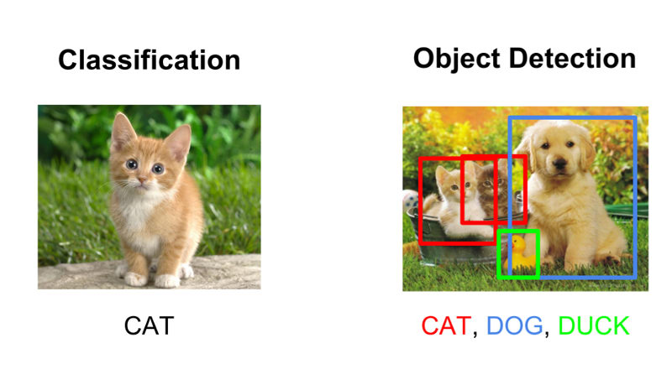
Classification vs Detection

Slide 8
Hand Detection
Technique: TensorFlow Object Detection API
Model: Single Shot Multi-Box Detector MobileNet (80 Classes)
Training: Google Collab
Input: Frame
Output: Box around object with its co-ordinates and corresponding label

Slide 9
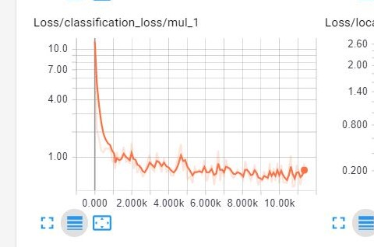
Training Graph

Slide 10
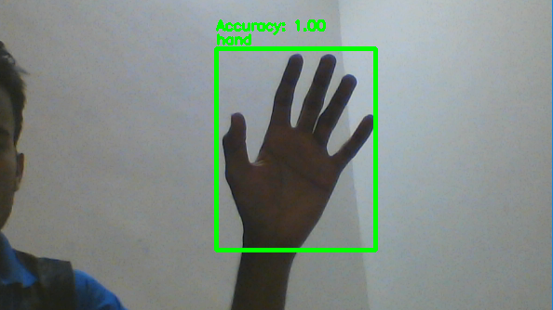
Hand Detection

Slide 11
Gesture Classification
Model: Inception
Input: Cropped Frame (containing hand)
Output: Label
Gesture Classified:
Fist
Two
Three
Four
Five

Slide 12
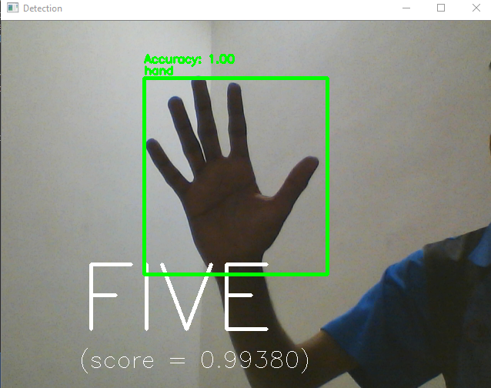
Gesture Classification

Slide 13
User Interface
4 Major Components
Login Page
Authenticate user
Dashboard Page
Run app
List of available patients
Settings Page
Add new Patient
Modify/View patients
Display app path configuration

Slide 14
User Interface
Library: TKinter -> Truly cross platform
File chooser : No need to remember path to the app’s exe
Native python libraries : No external dependencies except passlib
Security : Only hashed passwords are used & compared
Modular in view and control : Extendable

Slide 15
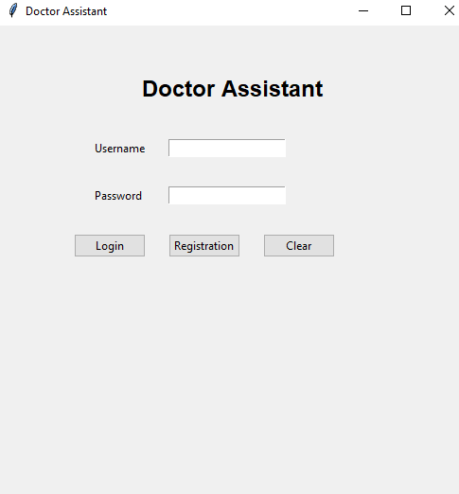
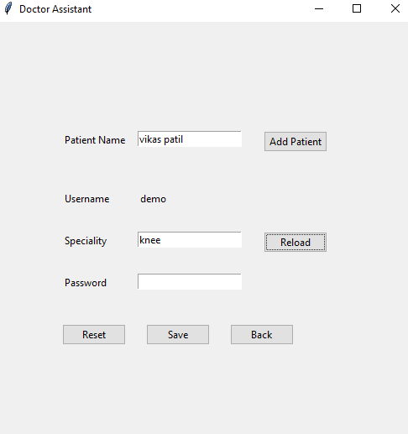
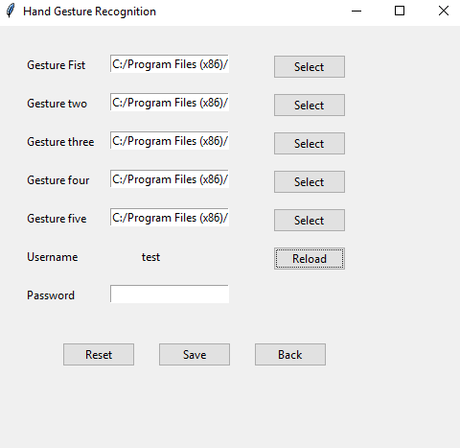
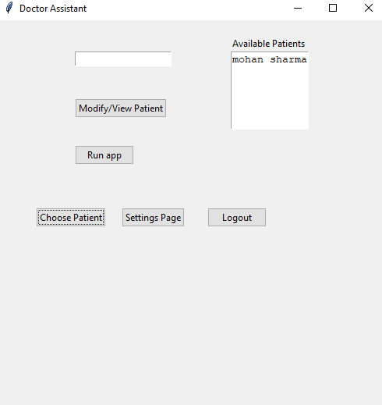

Slide 16
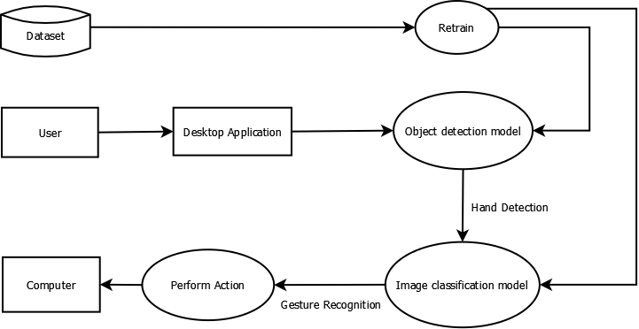
Dataflow Diagram

Slide 17
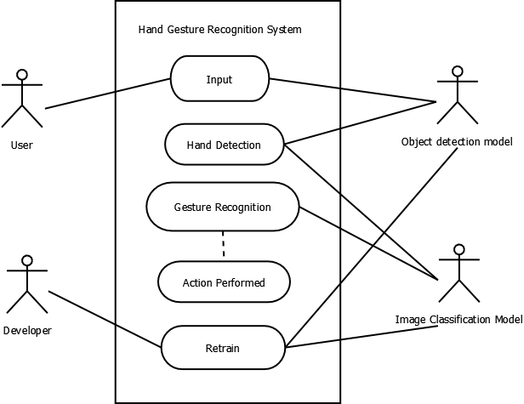
Use Case Diagram

Slide 18
Actions
Modes
Command mode
Normal mode
Actions on:
Image
Zoom in/Zoom out
PDF
Page up/down
Video
Volume increase decrease
Pause/resume

Slide 19
Conclusion
Fill the current gap in HCI
Removes the need of specific devices i.e. color markers etc.

Slide 20
Project Recognition
best departmental project award by Samruddhi TBI foundation

Slide 21
Thank You

